Slide 1
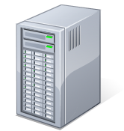
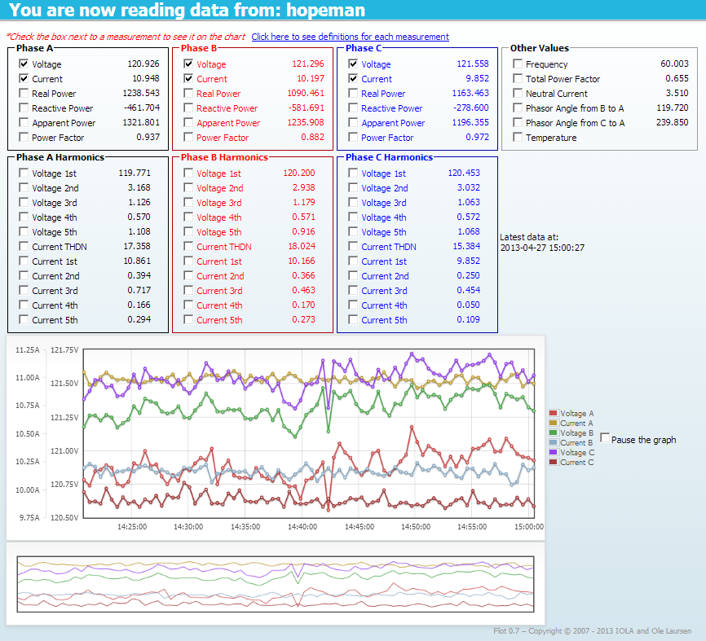
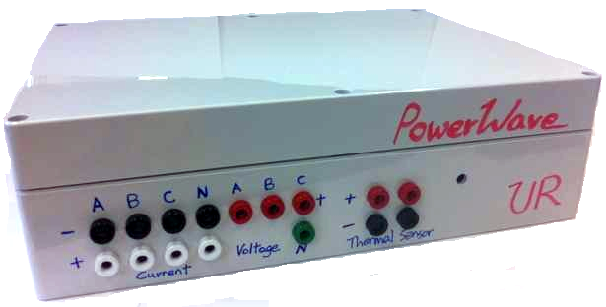
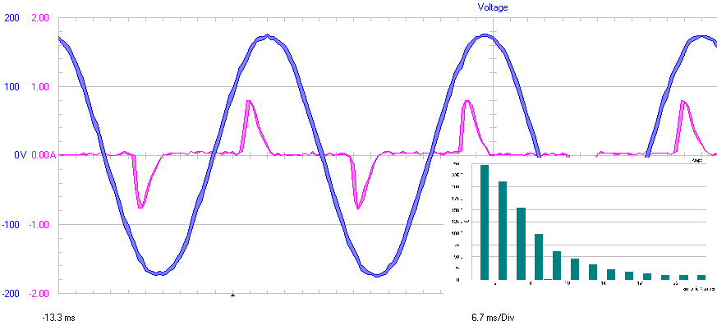



POWER WAVES
Senior Design Project by Ka (David) Fung and Pak Lam (Jack) Yung
Mentor: Professor Thomas B. Jones
Department of Electrical and Computer Engineering, Class of 2013
A wireless multi-phase power monitoring system
Scalable and easy to install, Power Waves is the ideal system for keeping track of a building’s electrical power usage and quality. Combined with the online interface, monitoring and logging electrical power has never been easier.
Project Objective
To design and construct a system to monitor electric power consumption in a building and transmit the data wirelessly. The measurement device would be attached next to a building’s power source. The data would be transmitted wirelessly and be available online. The system consists of:
3-phase power measurement device with wireless capability
Web server
Online interface
System Specifications for the Measurement Device
Requires existing wireless network at the location where monitor will be installed.
Power Source: 9 V-DC from a wall adapter.
Different split core current transformers can be used for different current ratings.
USB connection for programming and maintenance.
Measurement set interval: 2 seconds, +½ second for each harmonic data point.
±5% measurement error from 30% to 150% of calibrated values (excl. harmonics)
±10% measurement error for harmonics
Measurement Device
Created using off-the-shelf components, including:
3-Phase power measurement chip from Maxim
Arduino Mega microcontroller platform
WiFly Shield from Sparkfun
Split core current transformers
Custom PCB board
Server
The server is the hub of the system. It is responsible for communicating with the measurement devices, storing data, and serving webpages for the online interface. For this project, a University of Rochester’s server is used.
Online Interface
Written in PHP and JavaScript, the interface is supported in all major browsers. For any installed device, one can:
View live data
Schedule data collection
View previously recorded data
Measurement Device
Server
Online Interface
Power Quality: a definition
The measure of electrical parameters that enables electrical systems to operate safely and reliably within the grid. Principal parameters include:
Voltage levels
Harmonic distortion
Load balancing
Power factor
Summary
Our device combines traditional AC power instrumentation with state-of-the-art wireless and monitoring technology. Together with other control devices, our system can be implemented as part of a “smart grid” scheme to improve management, fault detection, and allow self-healing of the power network and make the grid more reliable.
RMS Amps
Sample data of measurement accuracy. The measurement device under test had its current measurement calibrated to 1 A_{rms}. The calibration device is a Fluke model #43B Power Quality Analyzer.
Harmonic Number
Voltage (blue) and current (purple) waveforms of a typical CFL bulb. The current harmonic spectrum (teal) is in the lower-right.
Acknowledgements
This work is supported in part by the Strategic Training and Education in Power Systems (STEPS) of the US Department of Energy (DOE) and by a generous gift from the Xerox Corporation through the Xerox Summer Fellowship Program at the University of Rochester. We thank John Simonson from the U of R CNG for his guidance on the website and his permission to use the University’s server. We would also like to acknowledge Professor Wendi Heinzelman, Gabriel Unger, Lucas Crandall, and Douglas Bentley for their contributions to this project.

